Slide 1
PREDICTING APPROVAL RATINGS USING SOCIAL MEDIA DATA
Tim Hargreaves
WDSS Virtual Talk: Data Science for Politics
6th May 2020
Notes:
Welcome people to talk
Congratulate Ben

Slide 2
Introduction
Notes:
Start with introduction
Specifically, about me

Slide 3
My Background
MathStat Undergraduate
Placement Year at AstraZeneca
Mediocre knowledge of politics
Notes:
Key point: no special politics knowledge
Power of data science
Inspire people with knowledge of the field

Slide 4
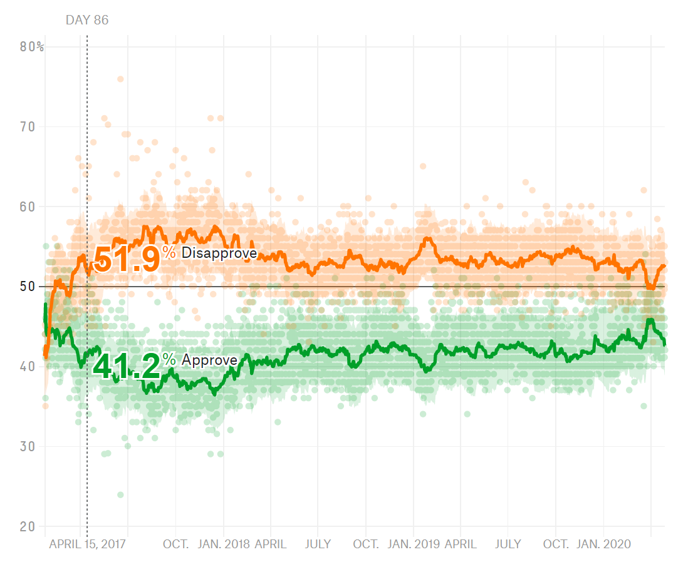
Objective
Predict Donald Trump’s presidential approval rating indirectly
Use social media data (Reddit) to achieve this
Take comments about Trump and analyse them to estimate sentiment

Slide 5
Why Reddit?
Highly vocal and opinionated
Wider spectrum of views
Lots of easily accessible data
Subreddits allow insight into different communities

Slide 6
Data Source in Numbers
6.5 Billion Comments
Spanning 15 years
1.2 TB Storage
Source: https://console.cloud.google.com/bigquery?project=fh-bigquery&page=table&t=all&d=reddit_comments&p=fh-bigquery

Slide 7
Sentiment Analysis
Notes:
Going to be using sentiment analysis
What is it?

Slide 8
The High-level View
Simplest form: determining if text is positive or negative in sentiment
More advanced: determining actual emotion (anger, confusion, joy, etc.)
Two approaches:
Unsupervised: works for any text data
Supervised: requires human labels of overall sentiment
We will keep things simple…
Notes:
Unsupervised: pattern detecting without explicit learning
Example of supervised: movie reviews (learning required, e.g. reference to Spielberg)
In simple, unsupervised requires no labelled data

Slide 9
A Basic Example
“I love pizza”
“This film is boring”
[0]
[+0.8]
[+0.1]
[0]
[+0.1]
[0]
[-0.7]
[+0.3]
[-0.15]
But how do we determine the individual scores?
We use an existing lexicon, e.g. Bing, AFINN
In other words, it’s already done for us
This is a over-simplification but the general idea is accurate

Slide 10
Handling Subtleties
“That was not fun”
“She is incredibly talented”
[0]
[0]
[×(-1)]
[+0.6]
[0]
[0]
[×1.5]
[+0.6]
[-0.6]
[+0.9]
[-0.15]
[+0.225]
Some language features are difficult to handle correctly:
Sarcasm and irony
Non-text features (emoticons, punctuation, etc.)
This is a over-simplification but the general idea is accurate

Slide 11
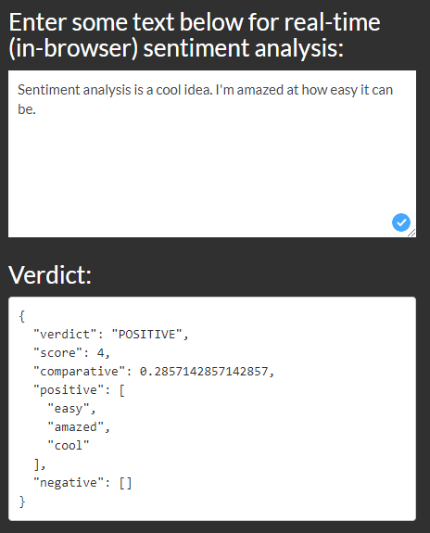
Try It For Yourself
A real time implementation of the AFINN lexicon can be found here:
https://darenr.github.io/afinn/

Slide 12
Data exploration

Slide 13
Dataset Overview
Column Name | Description | Type
body | Text content of the comment | Text
author | Username of the comment author | Text
created_utc | Date of comment creation (seconds since 1970) | Integer
score | Upvotes minus downvotes | Integer
controversiality | Comment marked as controversial | Binary
gilded | Number of golds given to comment | Integer
subreddit | Name of the subreddit the comment was in | Text
And several more columns of lesser interest

Slide 14
Random Sample
body | author | score | subreddit
Let Trump implode... or explode, we're not picky. | DonutsMcKenzie | 2 | politics
Who needs R Kelly when Trump is around | Chemicalbagel | 1 | politics
But, when will Trump be arrested? | 0125383 | 8 | politics
I gave Trump 2 years.......tic...tic...tic... | dgrant92 | 4 | democrats
So like Trump but smarter? | therecordcorrected | 1 | democrats
The Trump Recession. | red_carpet_hero | 5 | democrats
President Trump is a habitual line crosser. | pandawdy | 5 | republicans
RyanCare? I thought Trump was firmly in charge. | BaronBifford | -6 | republicans
I knew Trump wasn't all bad | Mooshtonk | 1 | republicans
And several more columns of lesser interest

Slide 15
Initial Observations
Signal is weak but present
Definite negative skew
Sarcasm will be an issue
Clear hyperbole

Slide 16
Model Building

Slide 17
Analysis Method
Split comments into months from January 2017 to October 2020 (34 observations)
Calculate average sentiment for (short) comments containing the word ‘Trump’
Scale to match range of approval rating

Slide 18
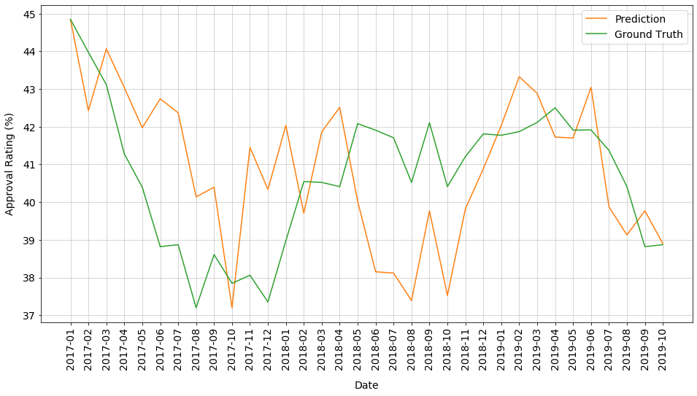
Results
Pearson’s r: 0.378
Insights
Reddit likes to overreact
Polls often lag behind Reddit
Indictment hit Reddit hard

Slide 19
Reflection
Correlation is weak but existent
Better metrics might available
The model is adequate but lacking subtly
Did not generalise to smaller subreddits
Still lots of space to explore:
More complex sentiment analysis
Combining sources
Weighting comments
Better data cleaning/processing

Slide 20
The Power of Data Science
<100
SLOC
Written in a few hours
Runs in <30 minutes

Slide 21
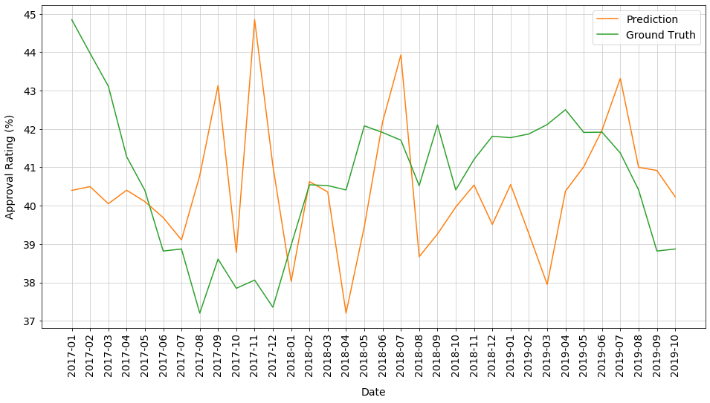
An interesting correlation
Pearson’s r: -0.08
Insights
Not enough data to draw strong correlations
Republicans defend Trump when he’s in trouble

Slide 22
Any Questions?

